Slide 1
Cryptocurrency
Analytics Based on Machine Learning
Sentiment
Prediction
Twitter Data
Cryptocurrency
Web application
Machine Learning
Yizhou WANG (669026)
Tzu-Tung HSIEH (818625)
Yunqiang PU (909662)

Slide 2
Content
1
Introduction
2
Crawler + Model Construction
3
Website Display
4
Conclusions & Significance

Slide 3
2
Approach & Planning
Step to implement out project
Twitter Crawling
Feature engineering
Server deployment
Step2
Step4
Step6
Step1
Step3
Step5
Get price trend
Model Construction
Website display

Slide 4
1
Introduction

Slide 5
1
Cryptocurrency + Machine Learning
Why we choose to combine them together
Public: Overall sentiment across the tweet data
Gov: One with the authoritative power like CoinBase, Bitcoin
Official Tweet Account
X
“Combination”
As a tool for trade, they price for the cryptocurrency depend on the
user -- Human
Twitter– one of the biggest forum for Human to share there opinion
One feature of cryptocurrency is remove the limitation of space
The use of Twitter can release the limitation of space.

Slide 6
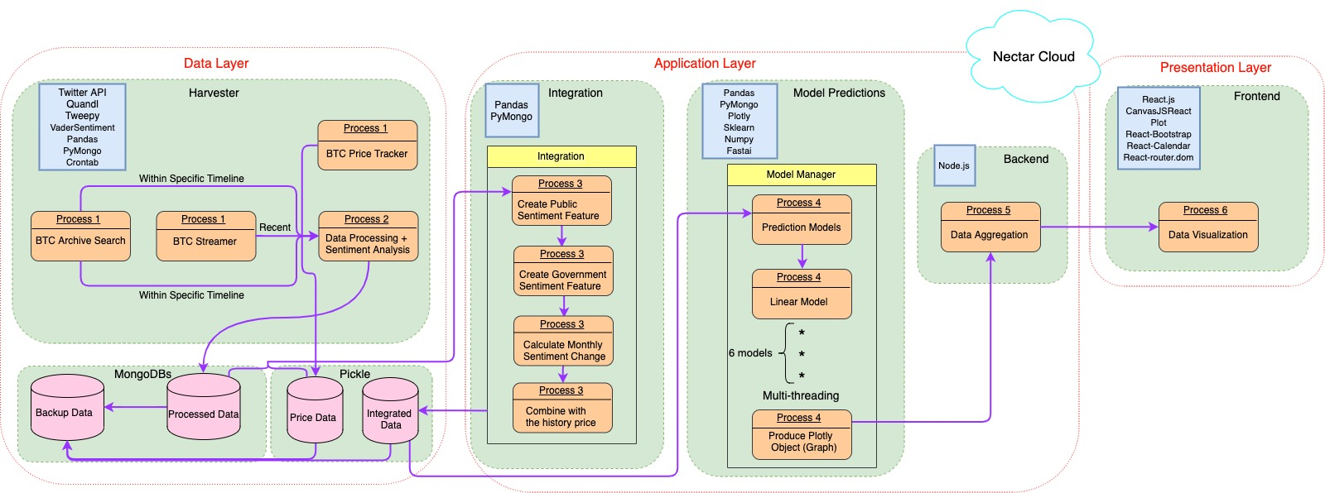
2
Overview
System Structure
Data Layer: Storage
Application Layer: Processor
Presentation Layer: Web

Slide 7
2
Crawler + Model Construction

Slide 8
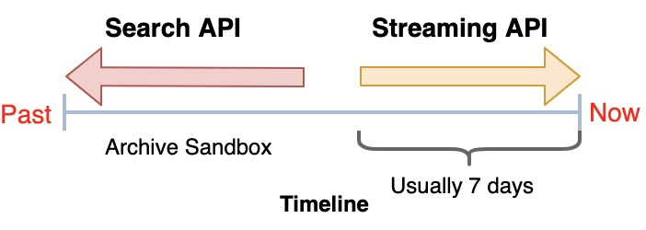
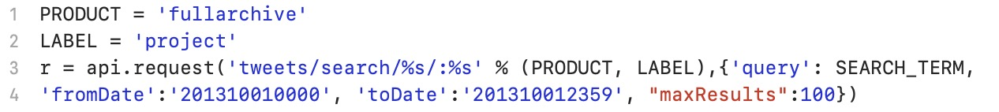
2
Crawler + Model Construction
Crawling
Combination of
Search API (Archive)
Streaming API (Recent)
Tweet preprocessor
Sentiment Analysis …VaderSentiment

Slide 9
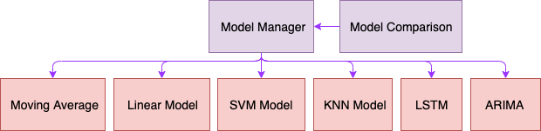
2
Crawler + Model Construction
Model Structure
Twitter Dummy Variable
Multi-threading…
MA
ARIMA
Linear
KNN
SVM
LSTM RNN
Implement Twitter Features

Slide 10
3
Website Display

Slide 11
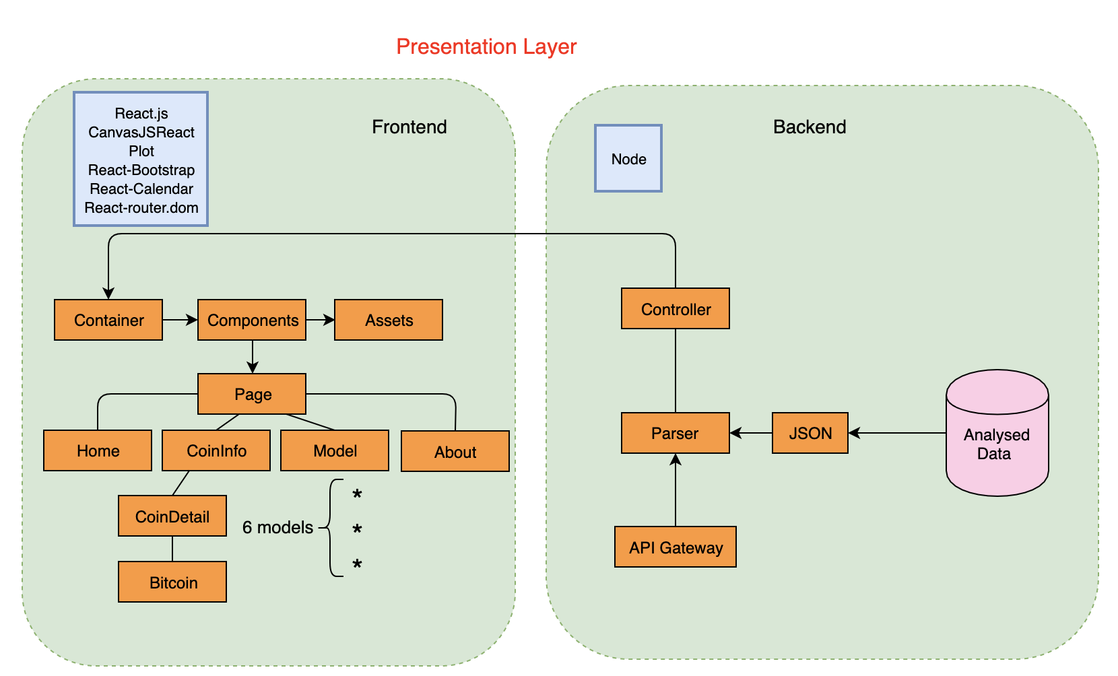
3
Website Display
Presentation Layer

Slide 12
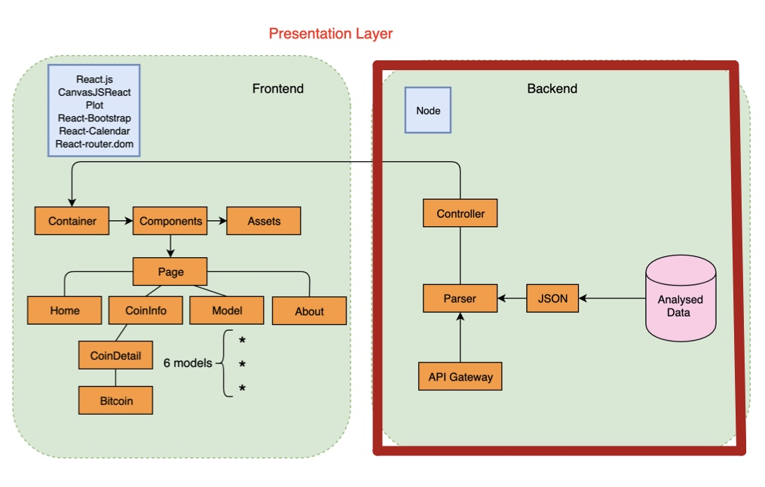
3
Website Display
Backend
Node.js
Parse API
Analysed data

Slide 13
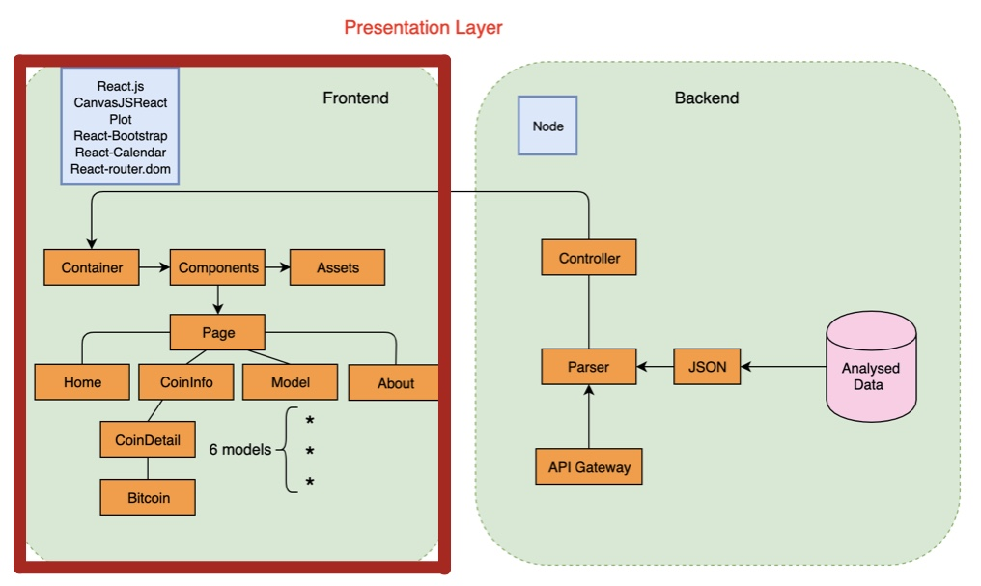
3
Website Display
Frontend
Container
Components
Assets

Slide 14
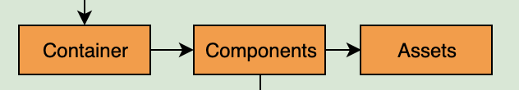
3
Website Display
Frontend
Container
Entrance of frontend
Router, address
Components
Each page
Element
Assets
Figures

Slide 15
3
Website Display
JavaScript Libraries
React.js
React-router.dom
React-Bootstrap
React-Plotly
CanvasJSReact
React-Calendar
and moment

Slide 16
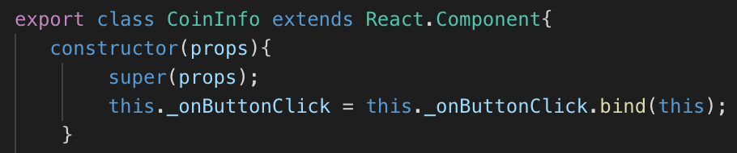
3
Website Display
JavaScript Libraries
React.js

Slide 17
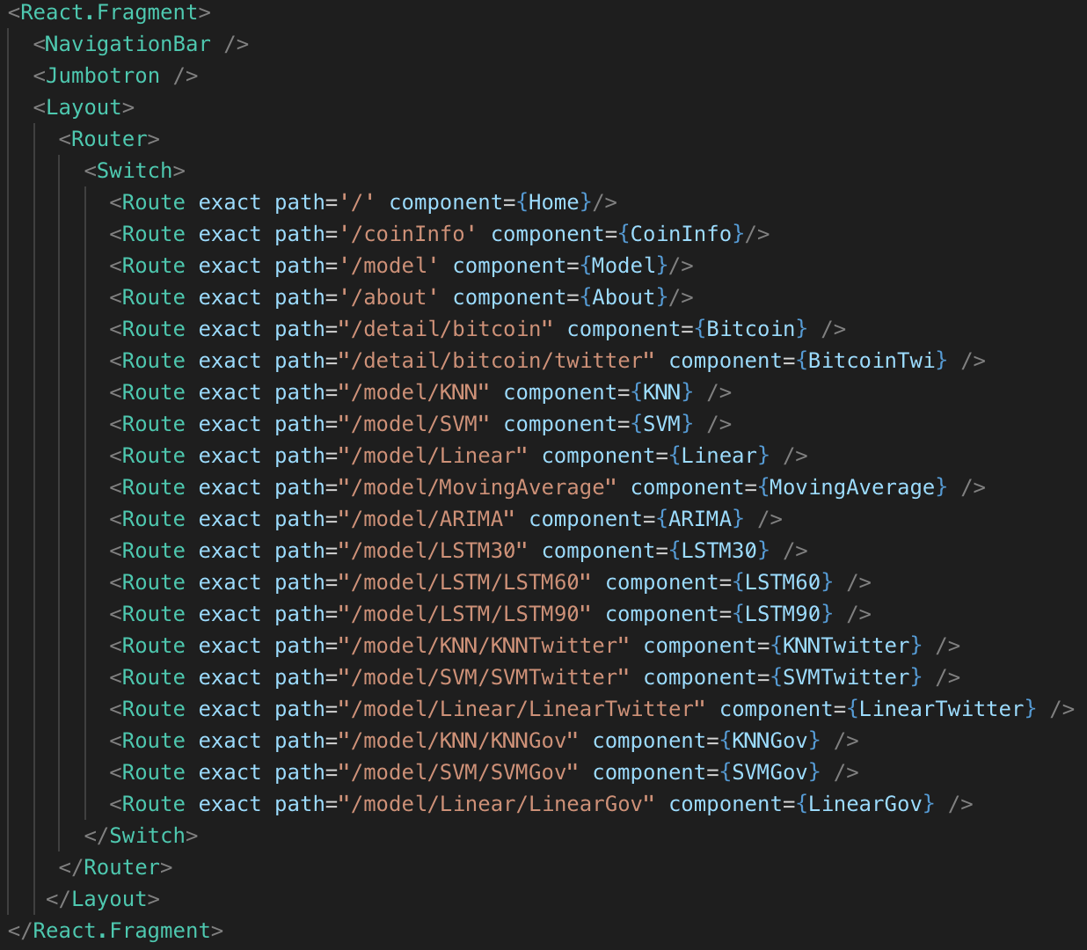
3
Website Display
React-router.dom
JavaScript Libraries

Slide 18
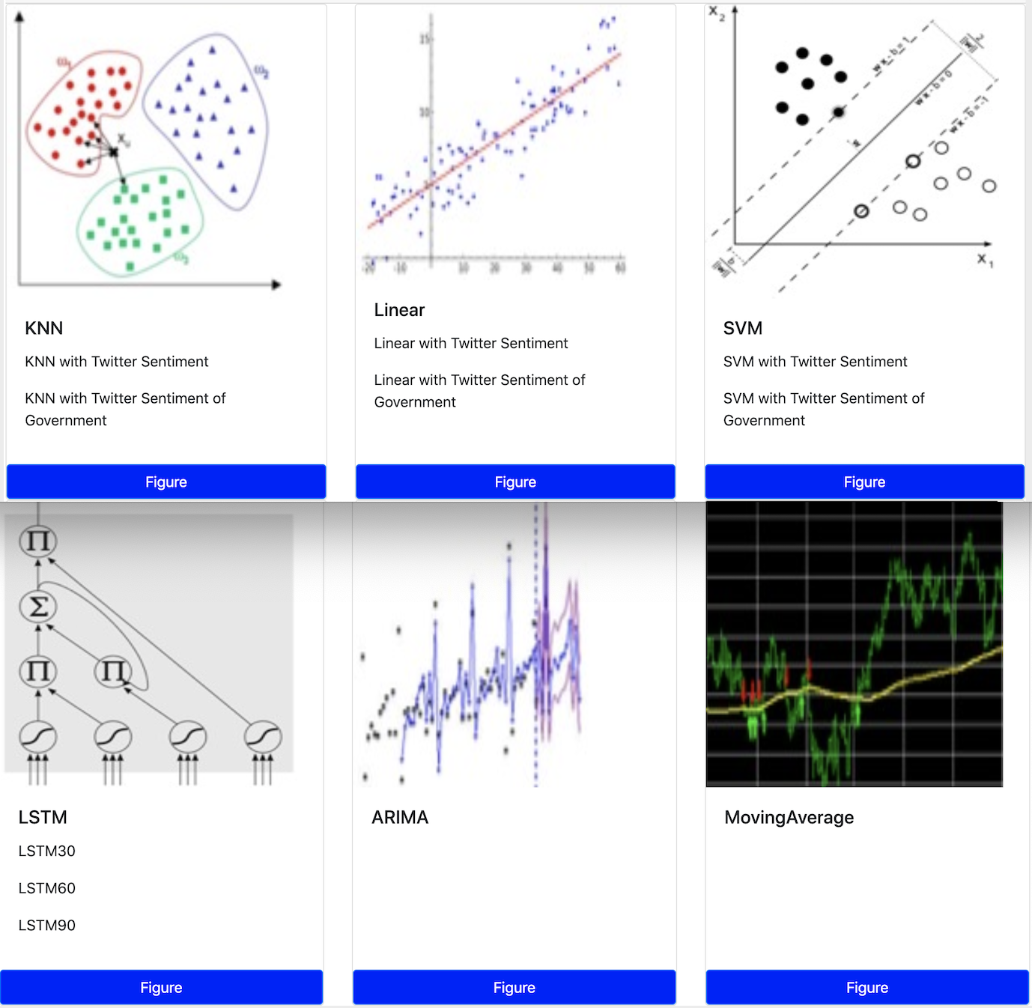
3
Website Display
React-Bootstrap
JavaScript Libraries

Slide 19
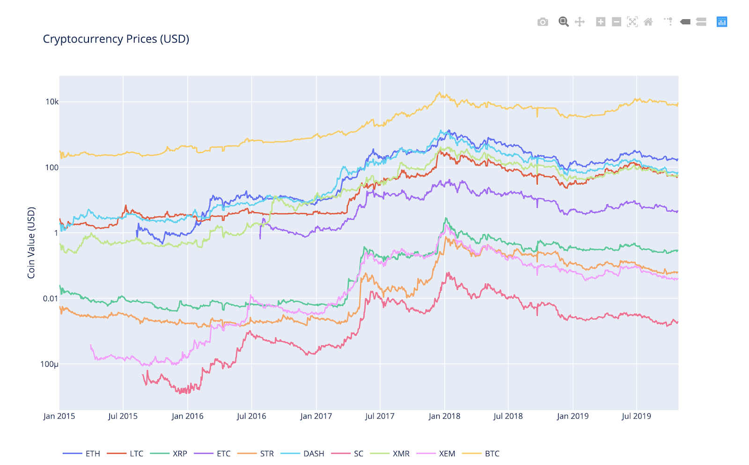
3
Website Display
React-Plotly
JavaScript Libraries

Slide 20
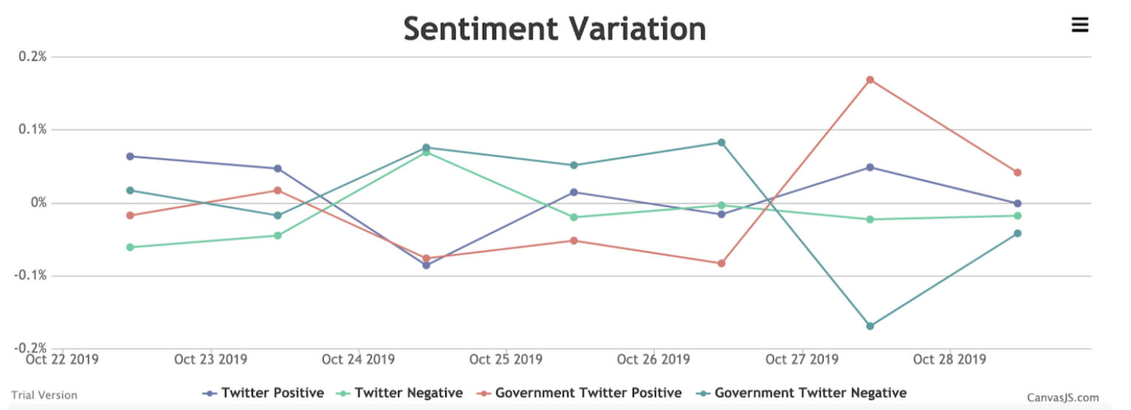
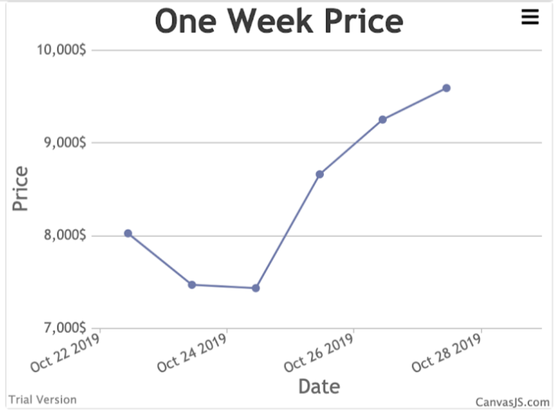
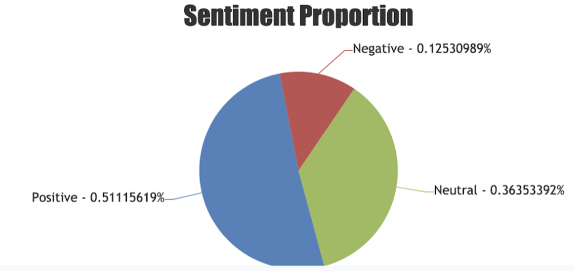
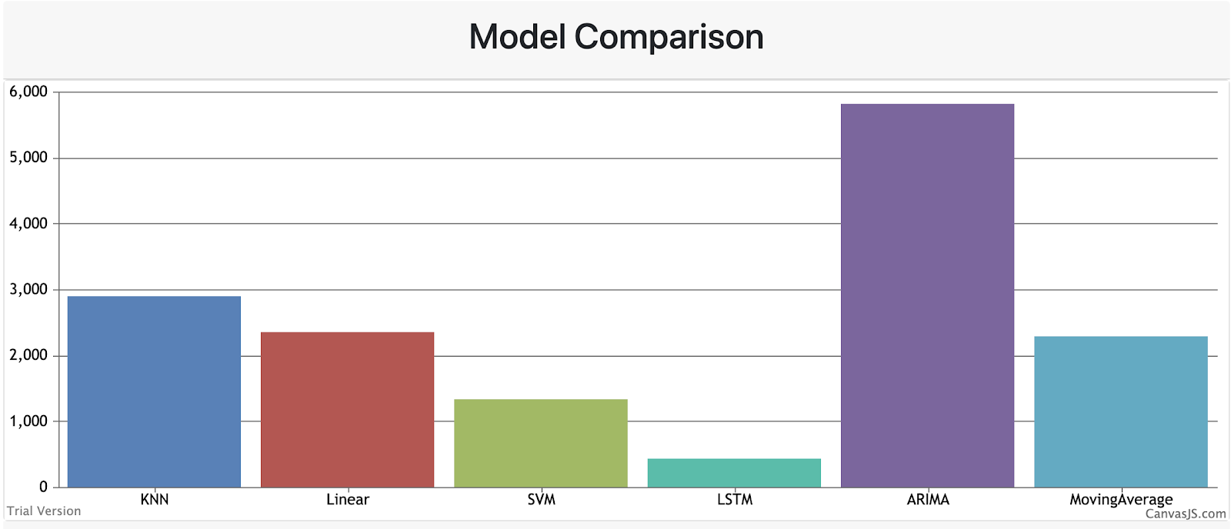
3
Website Display
CanvasJSReact
JavaScript Libraries

Slide 21
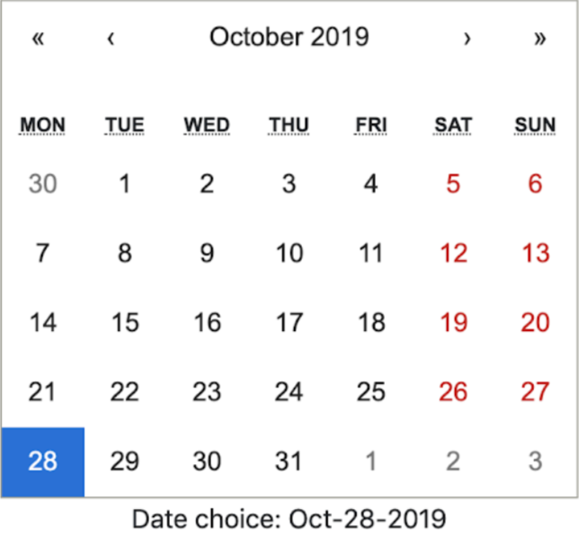
3
Website Display
React-Calendar and moment
JavaScript Libraries

Slide 22
4
Conclusions & Significance

Slide 23
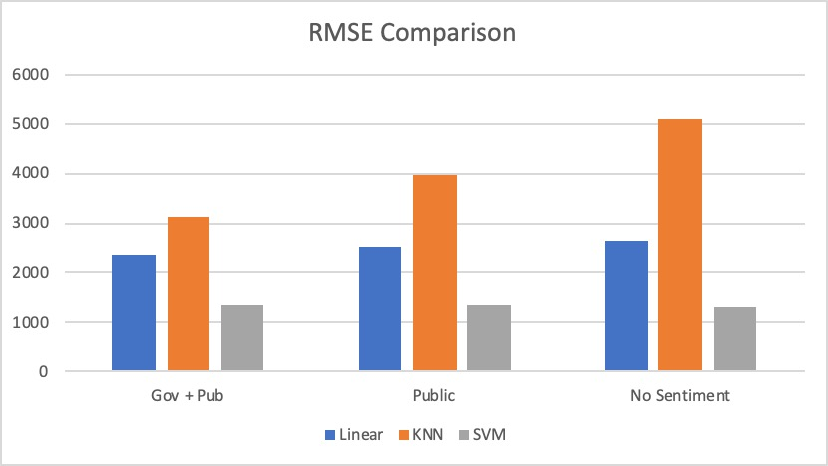
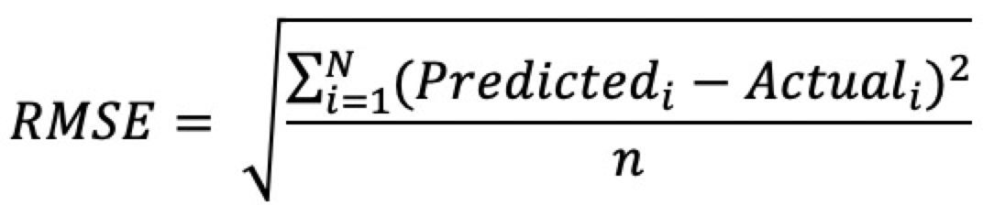
4
Conclusions & Significance
RMSE Comparison
Root mean squared error
Predicted error
The influence on the participant of government and public

Slide 24
4
Conclusions & Significance
RMSE Comparison
Predicted error
The influence on the participant of government and public

Slide 25
4
Conclusions & Significance
RMSE Comparison
The influence on the participant of government and public

Slide 26
4
Conclusions & Significance
RMSE Comparison
The influence on the participant of government and public

Slide 27
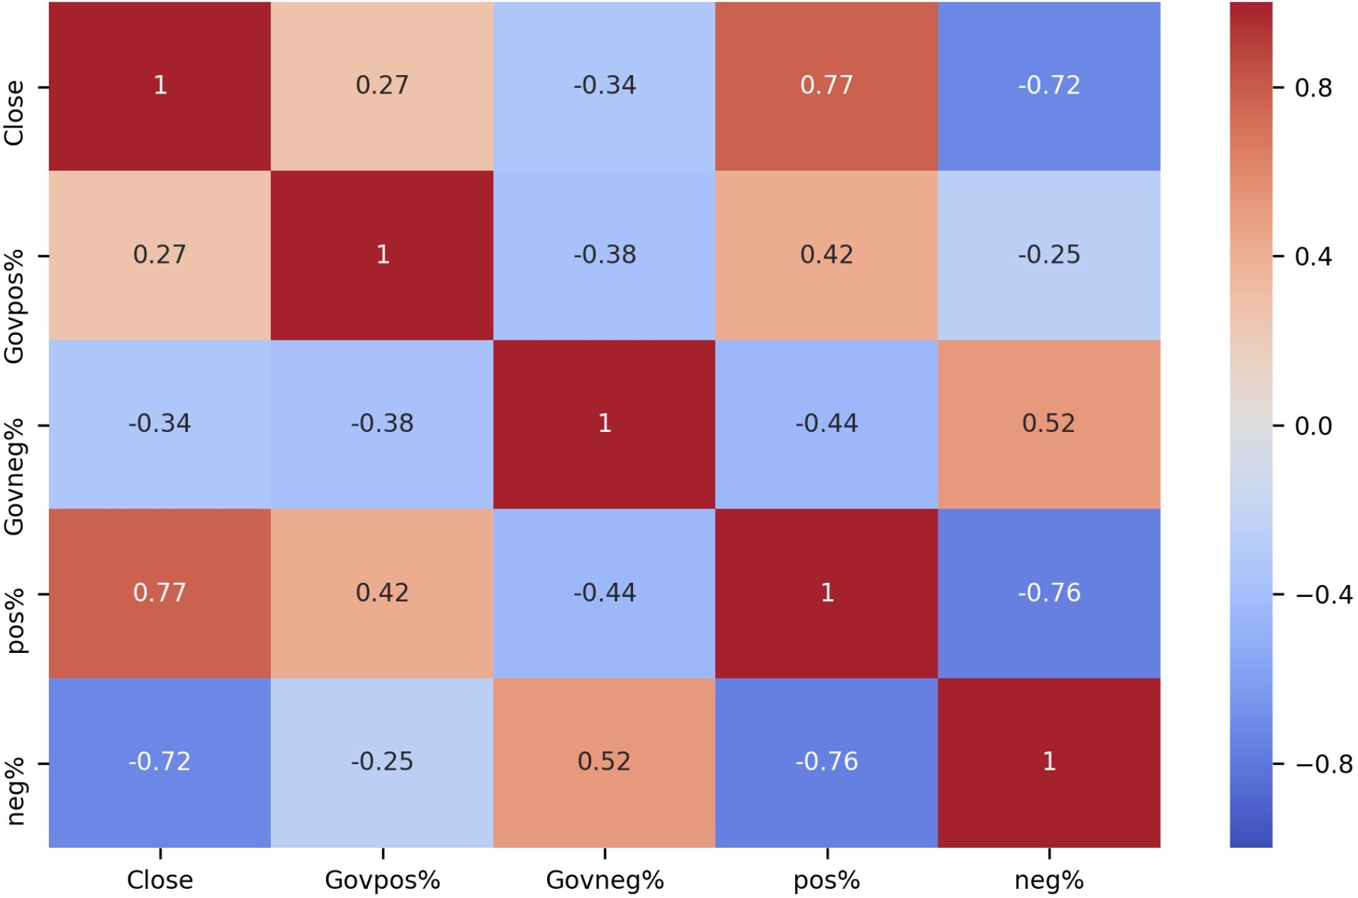
4
Conclusions & Significance
Correlation Matrix
price
price

Slide 28
4
Conclusions & Significance
Correlation Matrix
price
1.Price has positive correlation with Govpos, Pos
2.Price has negative correlation with Govneg, Neg
price

Slide 29
4
Conclusions & Significance
Correlation Matrix
price
1.Price has positive correlation with Govpos, Pos
2.Price has negative correlation with Govneg, Neg
3.Gov share the similar sentiments with public
price

Slide 30
4
Conclusions & Significance
Performance of different model
Principles of different model
ARIMA: Combine autoregressive models, moving average models, and difference methods
KNN: If the majority of the k-most nearest samples in a feature space belong to a certain category, then this sample also belongs to this category and has the characteristics of the samples on this category.
LSTM: an artificial recurrent neural network and keep track of arbitrary long-term dependencies in the input sequences.
SVM
KNN
ARIMA
LSTM
Linear
Moving_Avg
The error rate of different model under RSME
We tried 6 kinds of model of which the principle differ from each other a lot and performance also varies a lot.

Slide 31
4
Conclusions & Significance
Performance of different model
Principles of different model
12 times
improvement
ARIMA: Combine autoregressive models, moving average models, and difference methods
KNN: If the majority of the k-most nearest samples in a feature space belong to a certain category, then this sample also belongs to this category and has the characteristics of the samples on this category.
LSTM: an artificial recurrent neural network and keep track of arbitrary long-term dependencies in the input sequences.
SVM
KNN
ARIMA
LSTM
Linear
Moving_Avg
The error rate of different model under RSME
We tried 6 kinds of model of which the principle differ from each other a lot and performance also varies a lot.

Slide 32
Cryptocurrency
Analytics Based on Machine Learning
Yizhou WANG (669026)
Tzu-Tung HSIEH (818625)
Yunqiang PU (909662)

Slide 33


Slide 34
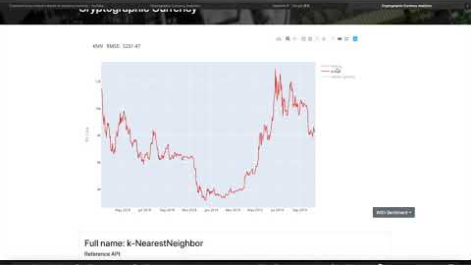
https://www.youtube.com/watch?v=vXfqrg6xQx8

